Slide 1
GROW YOUR OWN HERBS

Slide 2
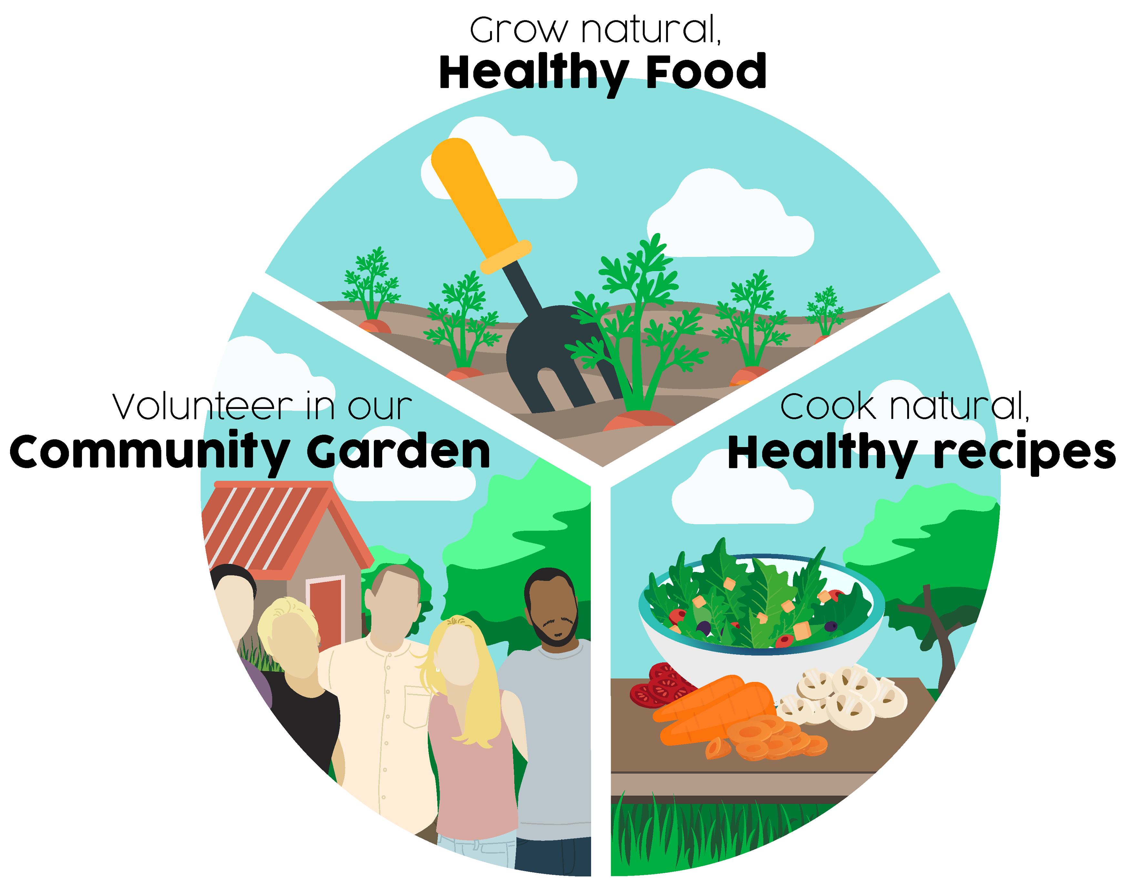

Slide 3
Herbs & how to use them
How to grow
A brief guide to how to grow a variety of different common herbs.
Growing conditions
Propagation
Pruning
Culinary uses
The best ways to use herbs in cooking
Other uses
Exploring preservation options
Non-medicinal uses

Slide 4
Thyme
How to grow
Perennial
Prefers a well-drained light soil and a sunny, sheltered position.
Grows slowly from seed with at least two years to harvestable leaves.
Choose a healthy plant at least 3 years old. Dig up early spring, gently tear the plant into 3 or 4 pieces with roots and foliage. Place each new plant back in the ground and water thoroughly.
Culinary uses
Works well with meaty dishes and is especially good as an ingredient in stews and stocks.
In Mediterranean cooking, thyme is a popular seasoning for lamb dishes.
You can also sprinkle over a fresh salad
Preservation
Dry: air or oven
Freeze: put freshly chopped leaves in ice cube tray. Top with water. Freeze
Oil: add freshly picked whole leaves to extra virgin olive oil
Vinegar: add sprigs to cider vinegar.
Butter: incorporate freshly chopped leaves
Honey: infuse with dried leaves

Slide 5
Marjoram
How to grow
Annual - unlikely to survive Scottish winter.
Grows best in full sun in a well-drained soil.
Sow seeds late April, 2cm deep, 15cm. After about 2-3 weeks, thin seedlings to 30cm apart to give the plants room to grow to their full size.
Culinary uses
Milder and more floral than Oregano
Sprinkle chopped marjoram over your favourite pizza and in meatballs or pasta sauce for a real Italian flavour.
You can also sprinkle over a fresh salad and it goes very well with cheese, egg and tomato dishes.
Preservation
Dry: Oven or air dry leaves
At end of season, lift the whole plant and hang upside down to dry until leaves are crumbly
Freeze: whole leaves flat between sheets of greaseproof then bag when frozen

Slide 6
Oregano (wild marjoram)
How to grow
Unlikely to survive Scottish winter.
Grows best in full sun and well drained soil.
Sow seeds from late April, 2cm deep, 15cm apart. In 2-3 weeks, thin to 30cm apart to give the plants room to grow to their full size.
Harvest in July before flowers appear. You can harvest up to November if flowers removed regularly.
Culinary uses
Is the best herb to use in pizzas. Freshly picked oregano even smells like a pizza!
It can be used to flavour several other dishes, including spaghetti bolognaise and chilli.
Oregano works well with many tomato dishes and can be added fresh to salads.
Preservation
Espresso Pepper Salt
1/2 cup sea salt, 1 tbsn fresh oregano, 1 tspn black pepper, 1/4 tspn cayenne BLEND
1 tblsn espresso
Spread on greaseproof paper and dry overnight.
Jar and store
Use as a dry rub for meat

Slide 7
Sage
How to grow
Perennial
Tolerates most conditions if it has full sun. Enjoys dry conditions.
Takes a long time to grow from seed.
Cut off a young shoot approx 6 cms below the leaf crown. Strip lower leaves, leaving three pairs of leaves. Pot in soil or compost.
Prune to half size after flowering. Mulch in Autumn to protect the roots.
Culinary uses
Works well with other herbs in the kitchen such as thyme, rosemary and basil.
Commonly used in stuffing mixtures for chicken but can also be used with roast lamb or pork dishes.
Why not try adding a few leaves to your cheese on toast.
Preservation
As Thyme
Sage salt: 1 teaspoon to ¼ cup of salt (to taste)
Sage bitters: Combine fresh sage with aromatics eg ginger and bitters eg citrus peel, (2 tsps) and vodka (100mls)

Slide 8
Parsley
How to grow
Parsley is a biennial so need to replace every two years.
Likes rich soil and plenty of moisture.
Seeds can be slow to germinate as needs quite high temp.
Harvest leaves as often as you like, leaving enough for regrowth.
Culinary uses
Not just for parsley sauce!
It has a lovely fresh flavour and works well with a wide variety of dishes from fish to potato and egg-based recipes.
Chewing a small sprig of fresh parsley is said to reduce the garlic flavour of your breath
Preservation
Ranch dressing:
8 tspn dried parsley
4 tspn onion flakes
1 tbsp dried dill
2 tsp garlic powder
2 teaspoons salt
2 tspn dried chives
1/2 tspn black pepper
Add to mayonnaise

Slide 9
Dill
How to grow
Grown as an annual herb as not tolerant below -4.
Thrives in most conditions.
Very easy to grow from seed, sprinkle on ground in April, cover lightly.
Cut the plant to within 3cm of its base, just before the flower heads open to produce a second cropping.
Or allow to set seed and harvest.
Culinary uses
Has a pleasant light, almost grassy taste and goes well with cucumber in sandwiches.
The freshly cut leaves can be chopped up in salads and egg and fish dishes.
Dill is great in mayonnaise for boiled new potatoes.
Preservation
Dry: leaves & seeds
Dill pickle: cucumbers, beans
(vinegar, salt, garlic, coriander seeds, black peppercorns)
Dill infused vodka

Slide 10
Chives
How to grow
Perennial
Tolerant of pretty much all conditions.
Grows easily from seed, scatter on ground April, lightly cover.
Split existing plants March or October and re-plant bulbs.
Cut as much as you like, always leaving 5cm above ground for re-growth
Culinary uses
Have a mild onion flavour and can be chopped up and added to salads and a variety of potato dishes including mashed and baked potatoes.
Chive flowers are also edible and purple flowers make a plate of salad look extra interesting!
Preservation
Freeze in ice cubes
Add chive flowers to white vinegar for purple vinegar tasting mildly of chives

Slide 11
Rosemary
How to grow
Perennial
Prefers a light, sandy soil of medium to low fertility. Will tolerate dry conditions.
Difficult to grow from seed. Take cuttings May-June. Take 7.5cm from young shoots, strip leaves from the lower half. Pot with a mixture of sharp sand and standard potting compost. Grow on out of direct sunlight.
Prune in Autumn
Culinary uses
Simply place a few sprigs of fresh rosemary on top of the meat before roasting for a wonderful Mediterranean taste.
Lamb can be flavoured by inserting chopped rosemary into small holes pierced into its skin before cooking.
Preservation
Rosemary syrup:
1 cup sugar 1 cup water 4 rosemary sprigs
Bring to boil
Cool, Strain, Bottle

Slide 12
Mint
How to grow
Perennial
Tolerant of most conditions but does best in the shade.
Grows easily from seed.
For cuttings, take a small piece of root and put it in a pot.
Can be invasive so grow in a pot sunk in the herb bed.
Cut back as hard and often as you like.
Culinary uses
Great for digestion
Traditionally made into a mint sauce to be used as an accompaniment to roast lamb.
Its leaves may also be used fresh and mixed into all sorts of vegetable, fish and meat dishes.
Also used to flavour drinks, such as mint tea.
Preservation
Dried: Mint tea
Infused: Mint rum (mojito)
Mint sugar (bruise and add 4 sprigs per cup sugar. Leave 2-3 days
Peppermint oil: fill jar with bruised leaves. Cover with oil. Infuse 2-3 days. Strain, Bottle.
Wasp Spray: 100ml vinegar, 100ml water, 1 tspn oil

Slide 13
Bay
How to grow
Perennial- Hardy to -7.
Tolerant of most soil types. Grow in sunny sheltered spot. If in a container bring inside during winter, outside protect with fleece.
Cut a 15 cm length from the end of a stem, strip all but the top couple leaves and pot in good growing medium
Prune each Autumn by snipping the excess foliage away.
Culinary uses
Commonly used in 'bouquet garni' to flavour stews and soups.
They have a pungent flavour when eaten fresh and a more subtle flavour when dry.
They are best removed from the meal prior to serving or can be crumbled finely.
Preservation
Best stored frozen

Slide 14
Contact
Email: robin@abundantborders.org.uk
Web: www. abundantborders.org.uk
Social Media: facebook.com/abundantborders

